Slide 1
See Part 1
(Slides 1-8)

Slide 2
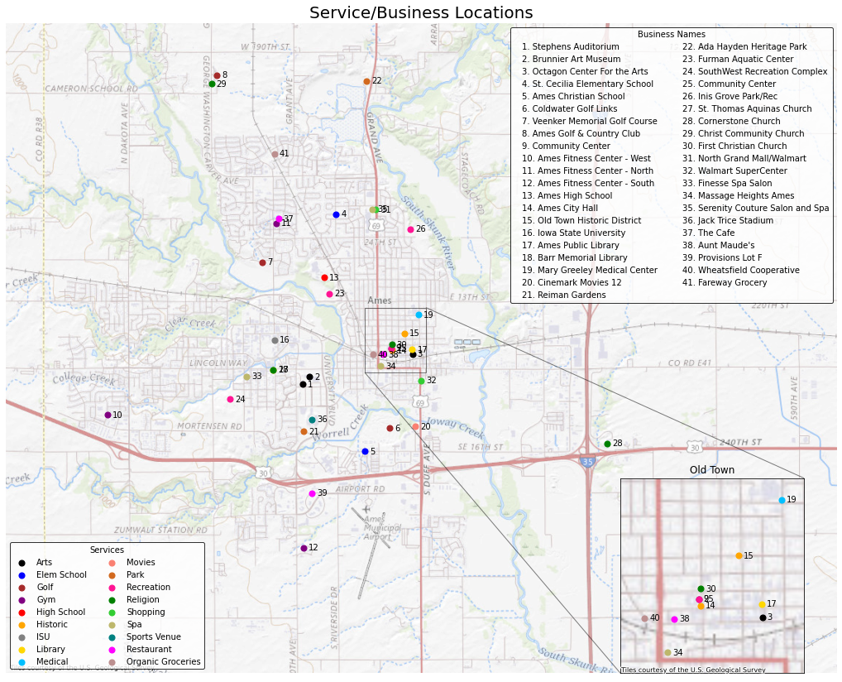
Services & Businesses
Services:
Service selection based on possible interests of out-of-town home buyers
Example services: Organic Grocery stores, Parks, High Schools, Gyms and Religious Institutions
Businesses:
Business selection based on quality ratings from search engines (e.g., Google, Yelp) and popularity
Most businesses are located in the downtown area (i.e., Old Town)

Slide 3
Feature Engineering
House Feature Engineering:
Areas:
Total Area: Gross Living Area + Basement Area
Total Area with Garage: Total Area + Garage Area
Amenities:
The following boolean flags were created for the presence of amenities:
Fireplace
Basement
Garage
Latitude and Longitude:
For each house, the latitude and longitude were calculated using GeoApify and verified using Nominatim’s reverselookup function
Unsuccessful queries were manually corrected using Google Maps
Distance and Drive Time Feature Engineering:
Distance:
For each home the Euclidean distance to each business was calculated
Drive Time:
The drive time from the closest business (per the Euclidean distance) for each service was then calculated using OSMR API
Analysis:
The following fields were calculated based on the drive time
Centrality: drive time from Old Town to each house
Convenience: average drive time from all services
Closest 5 services: average drive time from closest 5 services
Closest service: average drive time from the closest service
Number of Businesses within 3 minutes and 8 minutes of each house
Notes:
Using preliminary descriptive linear models, time presented a higher R^2 than driving distance. This is probably because drive time takes road conditions into account (number of traffic lights, stop signs, traffic conditions, street directions etc)

Slide 4
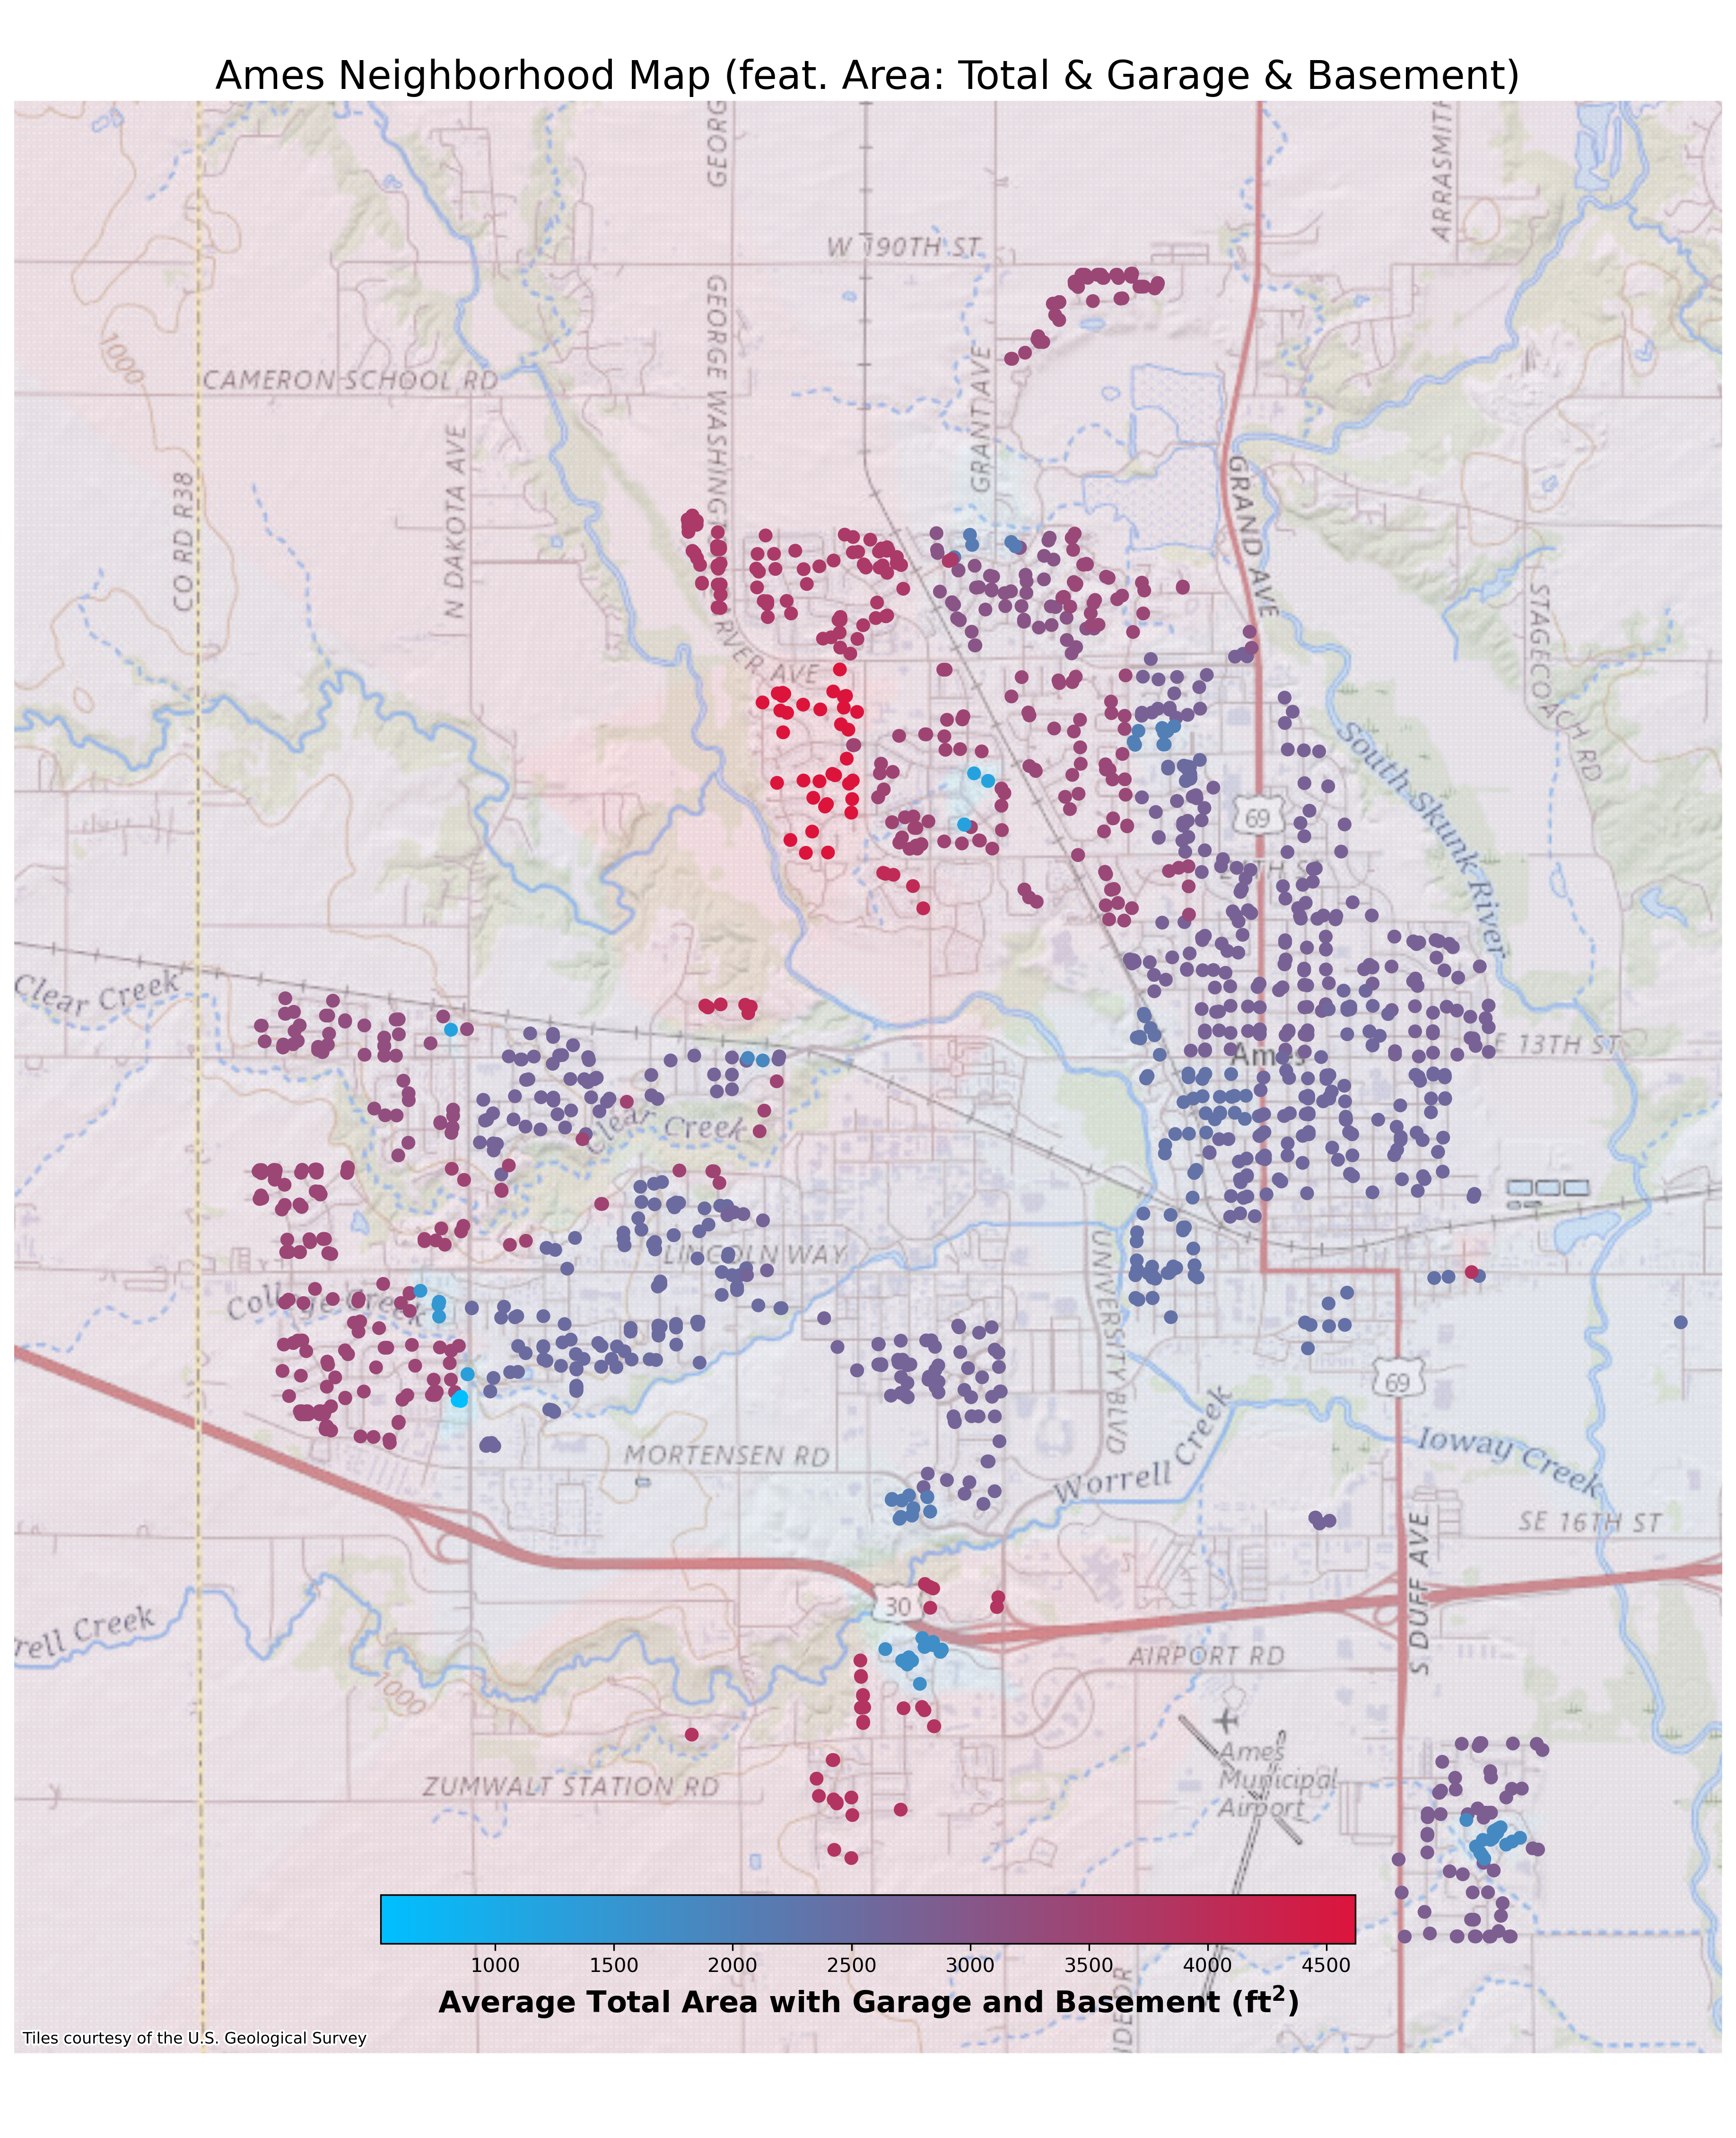
Feature Engineering
Total Area with Garage:
Neighborhoods in the northwest of Ames have the largest average total house area with garage
Condo neighborhood subdivisions and Old Town have the smallest average total house area with garage
Based on previous maps, the sale price corresponds to larger living area (e.g., North Ridge)

Slide 5
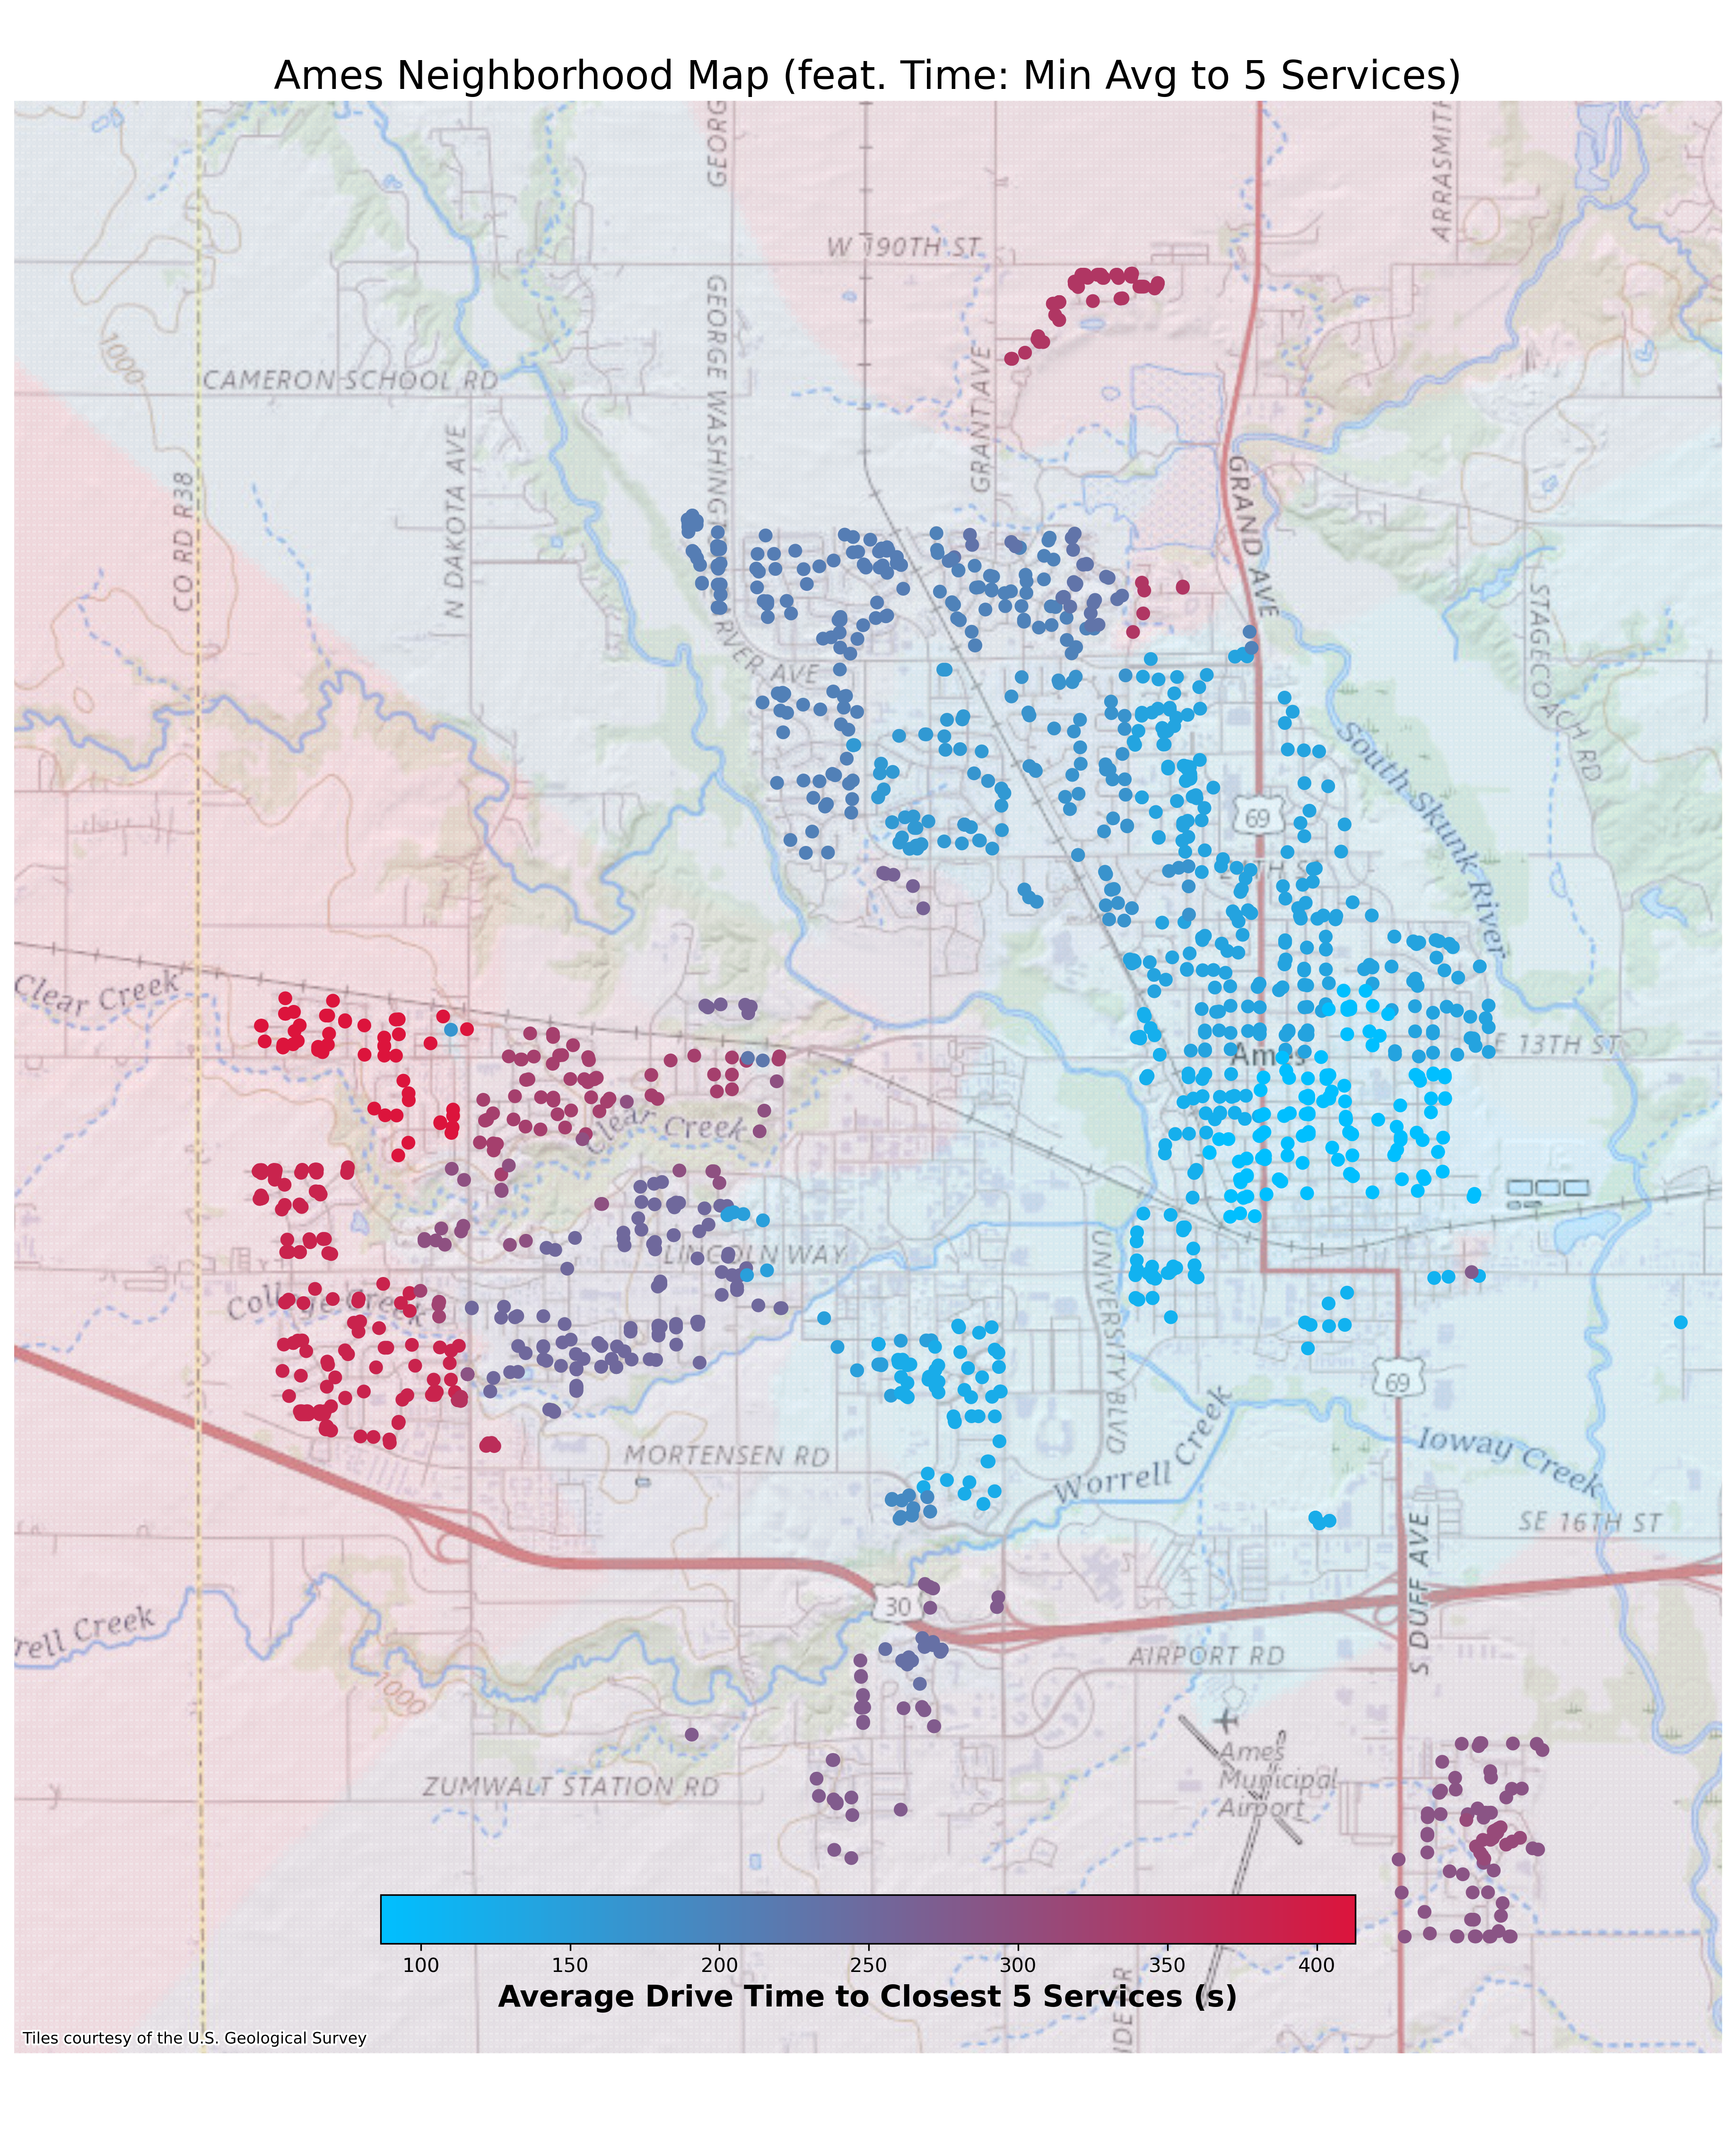
Feature Engineering
Closest 5 services:
Neighborhoods in the far west of Ames have the longest average drive times to the closest 5 services
Neighborhoods in the center and north of Ames have the shortest average drive times to the closest 5 services. Old Town has the absolute shortest drive time to closest 5 services as expected due to centrality
The effect on sale price due to the proximity to the closest 5 services is not entirely clear.

Slide 6
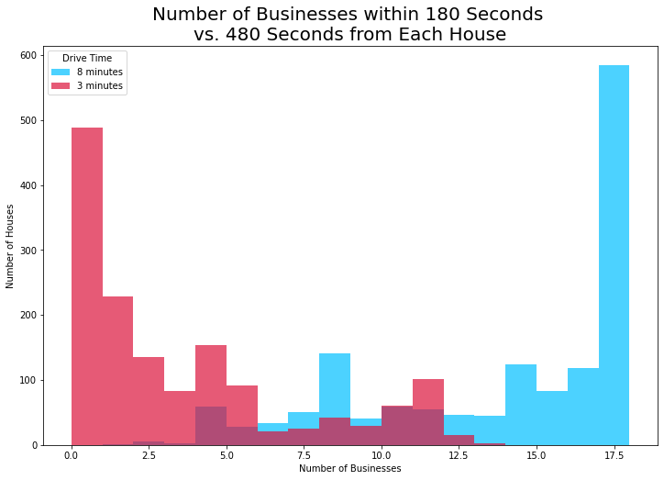
Feature Engineering
Number of Businesses:
1/3 of the houses are not 3 minutes drive time away from any service
>1/3 of the houses are 8 minutes drive time away from all services
Conclusion: most of the services lie within 3 to 8 minutes from each house

Slide 7
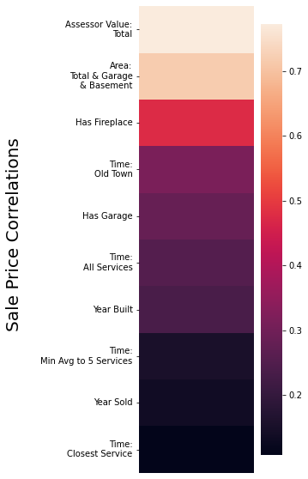
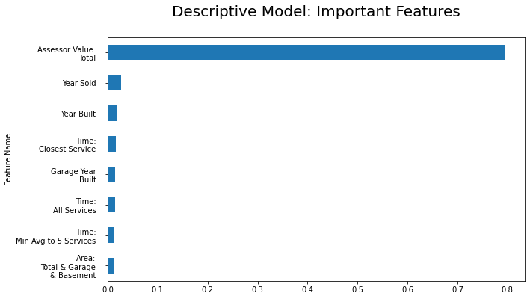
Feature Engineering
Feature Importance:
Feature importances were calculated using a descriptive Random Forest Regressor model for predicting Sale Price
Total Assessor Value is the most important feature
Feature Correlations:
Strongest positive correlations with Sale Price are Total Assessor Value, Total Area with Garage and Basement
Fireplace amenity is more correlated with Sale Price than garage amenity
Drive Time to Old Town has the strongest correlation out of all the drive time features

Slide 8
Feature Selection
Methods:
LassoCV: a penalized regression model
Variance Inflation Factor (VIF): manual elimination of features based off multicollinearity score
Sequential Feature Selector (SFS): iterative greedy algorithm that optimizes R² while reducing dimensionality
Results:
LassoCV and VIF were ineffective due to severe multicollinearity issues
SFS was used with tree-based ensemble regression to overcome multicollinearity issues
Both forward and backward SFS reduced the feature space to 37 features including:
Total Area with Garage
Other Assessor Value (i.e., dwelling value = total value – land value)
Sale Condition
Year Built

Slide 9
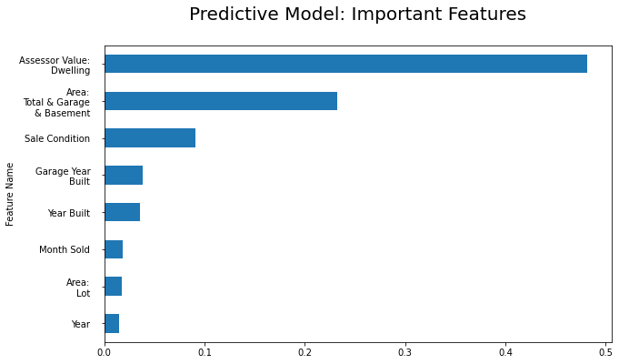
Final Predictive Model Selection
Regression models tested:
Multiple Linear
Support Vector
Random Forest
Gradient Boosting
Results:
Gradient Boosting Regression resulted in the best model
GridSearchCV was then performed to tune the models hyperparameters
The final optimized model performed with an R² of ~89%, which used the friedman_mse criterion and squared error loss function
Feature Importance:
Other Assessor Value and Total Area with Garage features had the highest importances with ~0.5 and ~0.25 respectively

Slide 10
Compare 2019 & 2021
AB Testing:
AB testing was performed to compare categorical features across both years
Neighborhoods: 2019 showed a preference for more moderately priced neighborhoods (Sawyer West) whereas 2021 seemed to split between more expensive and less expensive neighborhoods (North Ridge and Old Town)
Houses sold in 2021 show a preference for more bedrooms and more cars while also showing a preference for no central air, old heating tech (gravity heating), and old exterior materials (Wood Shingles)
In summary, the houses bought in 2021 had more extreme features and sale prices
Hypothesis Testing:
2021 sales reflected houses bought closer to services in general as seen by reduced average drive times from services (Closest 5 and All)
Feature | 2019 | 2021
Neighborhood | Sawyer West | North Ridge
 |  | Old Town
Building Type | Townhouse End Unit
Exterior Materials |  | Wood Shingles
Heating |  | Gravity
Central Air | Yes | No
Cars |  | 4
Number of Bedrooms |  | 5
Feature | 2019 | 2021
Closest 5 Services | 226.17 seconds | 214.03 seconds
All Services Average | 365.81 seconds | 352.44 seconds

Slide 11
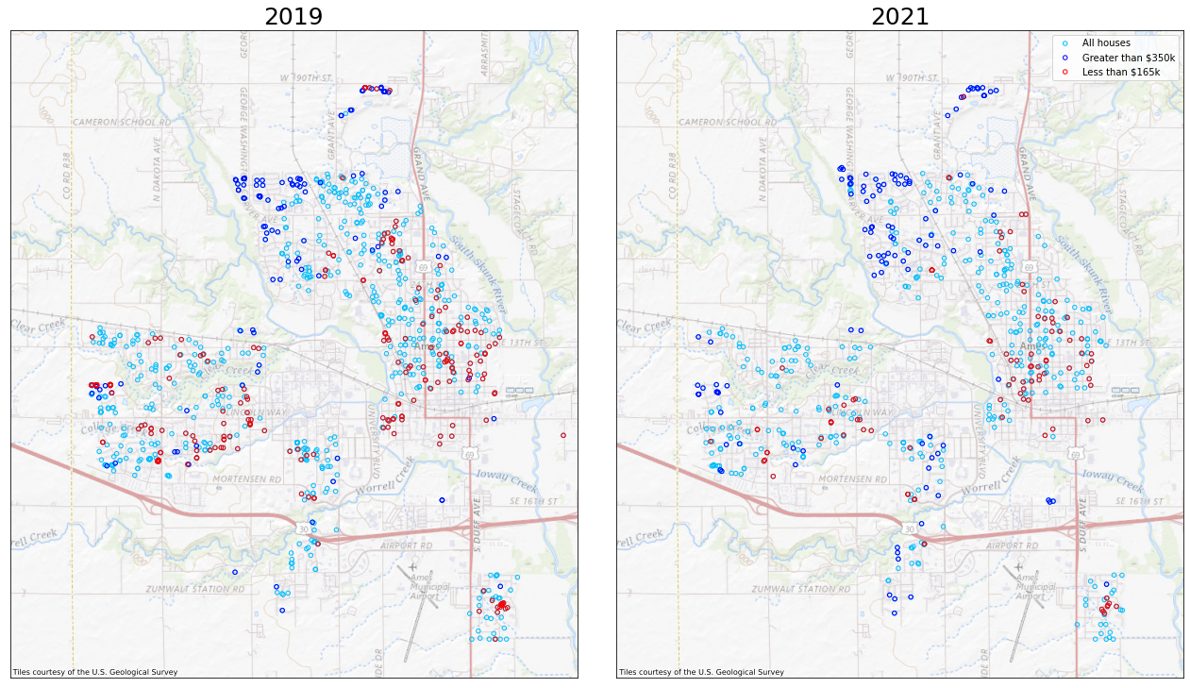
Compare 2019 & 2021
Sale Price:
2019 contains ~42% more records than 2021
2021 has larger proportion of expensive houses sold
Houses closer to the center of town cost less on average
Houses further from the center of town cost more on average

Slide 12
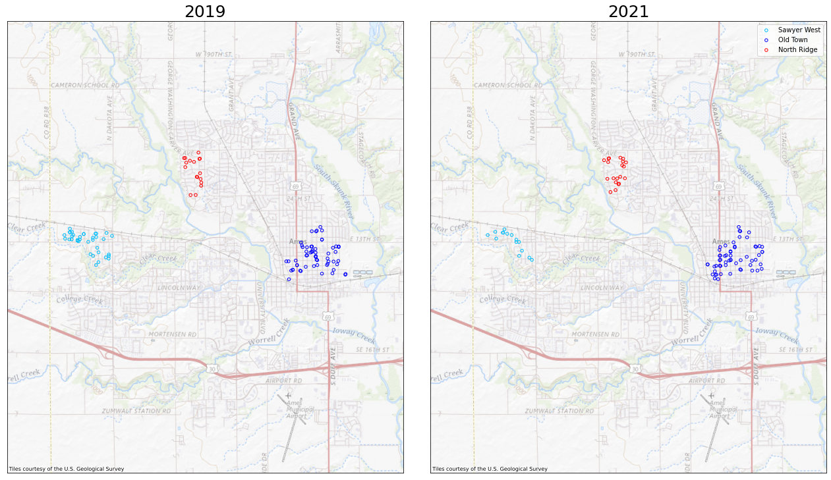
Compare 2019 & 2021
Neighborhoods:
North Ridge and Old Town house sales were proportionally greater in 2021
Sawyer West is favored for 2019 since it had more than double the house sales in that year
This plot corroborates the results of the AB testing

Slide 13
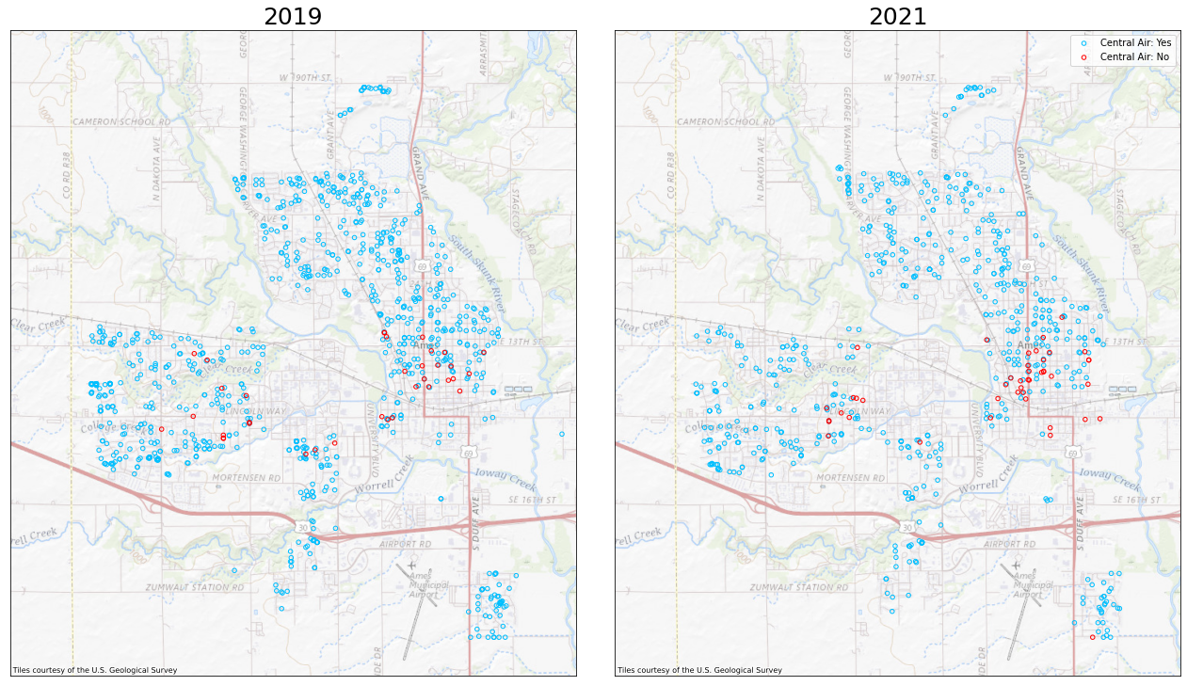
Compare 2019 & 2021
Central Air:
Old Town has the highest concentration of houses with no central air
In Old Town, the 2021 no central air records significantly outnumber those in 2019
The overall proportion of houses sold with no central air in 2021 is greater than in 2019, as corroborated by AB testing

Slide 14
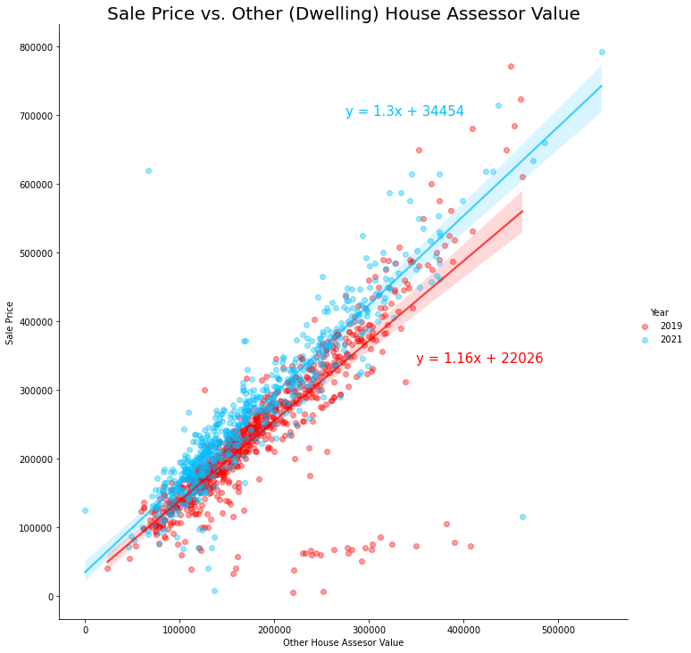
Compare 2019 & 2021
Sale Price vs. Assessor Value:
The cluster of records with Sale Price < $100k and Other House Assessor Value > $200k represent 2019 records with updated assessor values for 2021
Even though 2021 has a smaller number of records, there is a greater range of assessor and sale price values for that year
The plot shows that for 2021 there was a greater demand in the housing market since for any given assessor value, the sale price was higher than in 2019

Slide 15
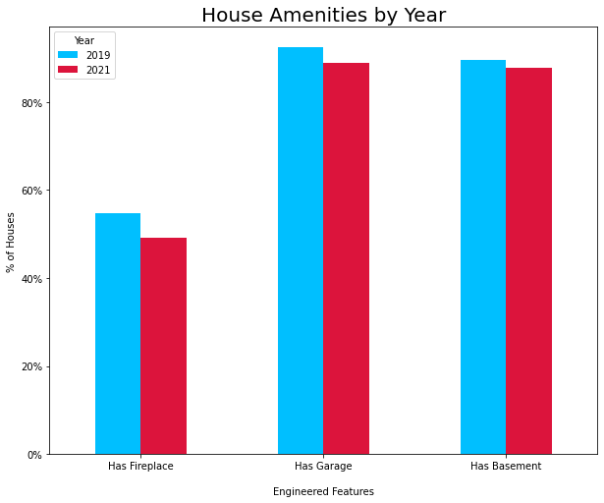
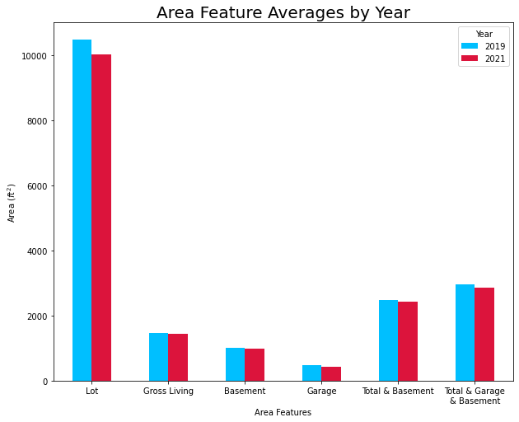
Compare 2019 & 2021
Sale records for 2021 proportionally has less amenities than 2019, even though it’s not significant based on AB testing
The lot area for 2021 was on average less than 2019, even though the total area with garage and basement were very close across years
This suggests that the houses sold in 2021 were less expensive than in 2019

Slide 16
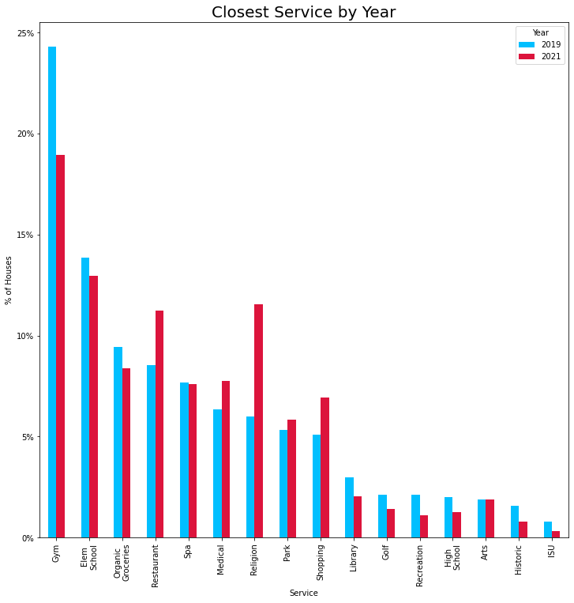
Compare 2019 & 2021
Closest Service by Year:
In 2019, gyms and recreation had a higher percentage of nearby house sales than 2021
In 2021, restaurant, religious, and shopping services had a higher percentage of nearby house sales compared to 2019
May have been a migration towards downtown from 2019 to 2021 since restaurant, religious, and shopping services located in center of town. Gyms and recreation services located more in suburbs

Slide 17
Sample House Sales
Method:
Similar 2019 records were chosen
Prices are within moderate range
Houses built post-war (>1946)
Want to predict sale price based on:
Changes to year sold
Addition of amenities
Proximity to certain services
 | Year Built: 1970 Sale ID: 22472 Original: $101,000 |  | Year Built: 1998 Sale ID: 4212 Original: $90,700 |  | Year Built: 1947 Sale ID: 14817 Original: $134,000
Changes | Prediction | Difference | Prediction | Difference | Prediction | Difference
Add Fireplace | $124,944 | 23.71% | $126,428 | 39.39% | $148,369 | 10.72%
Add Garage | $113,701 | 12.58% | $124,172 | 36.90% | $138,646 | 3.47%
Closest to Organic Groceries | $115,798 | 14.65% | $124,721 | 37.51% | $140,153 | 4.59%
Closest to Restaurant | $114,430 | 13.30% | $124,172 | 36.90% | $139,017 | 3.74%
Closest to Shopping | $112,033 | 10.92% | $122,966 | 35.57% | $136,978 | 2.22%
Closest to Religion | $111,464 | 10.36% | $127,277 | 40.33% | $141,751 | 5.78%
Year Sold 2021 | $121,251 | 20.05% | $130,130 | 43.47% | $142,253 | 6.16%
Results:
Sale IDs 22472, 4212 and 14817 represent townhome, a condo, and a single-family detached home respectively
The cheapest change for 2 out of 3 is having closest service as shopping
The most expensive change for 2 out of 3 is adding a fireplace
2021 housing prices are significantly larger than 2019 for all house types
Condos have the largest percent change when adding amenities, whereas single family detached homes have the smallest
Proximity to services has less of an effect on sale price than either year sold or amenities

Slide 18
Summary
House features:
Condos are generally cheaper due to their lower living area, lack of amenities, and distance from services, but single-family detached homes were by far the most dominant building type
Total Area with Garage and Basement and Assessor values were the best predictors of sale price. Increase in either value correlates with an increase in sale price
Cheaper houses are generally condos, are closer to historic district and high school services, have gravity heating, and have detached garages
Expensive houses are generally closer to religious and restaurant services, have a fireplace, and have larger attached garages
Pandemic effects on housing market in Ames, Iowa:
Home buyers migrated to properties that were:
Concentrated in the center of town
Closer to all services in general (especially religion, restaurants, and shopping)
Farther away from fitness and recreation services
Older in general
Houses sold by month were not mainly concentrated in the summer in 2021

Slide 19
Conclusion
Client concern: How close is the house to desired services (e.g., gyms, spas, organic groceries, hospitals etc.)?
Most houses in Ames are within 3 to 8 minutes of all services (gyms being the closest and ISU being the farthest in general). Because of the relatively small size of Ames, any service is within less than 8 minutes away
Client concern: How do specific house features affect the sale price?
The house amenities that have the greatest impact on sale price are the existence of fireplaces and central air. Fireplaces distinguish expensive homes from average homes, whereas central air distinguishes average homes from inexpensive homes.
Real estate firm concern: How did the housing market change due to the pandemic (i.e., 2019 vs 2021 data)?
House sale prices post-pandemic were more extreme in 2021 than in 2019. Real estate agents should focus on selling homes that are less expensive or more expensive than average
Real estate firm concern: How does the proximity to given services impact sale price?
Based on the predictive model, proximity to any given service has no real effect on sale price
Real estate firm concern: What neighborhoods would this particular client group prefer?
Post-pandemic, the best neighborhoods to recommend would be North Ridge and Old Town which are both convenient to all services. However, North Ridge is best for families and Old Town is best for single individuals.

Slide 20
Future Work
Data:
Add additional records, from years 2018 and 2022, to increase the accuracy of the predictive model and better predict the effects of the pandemic on the housing market
Cultivate more information about remote workers moving from larger cities to smaller towns to determine their preferences
Services:
Add more services in the western part of Ames
Use a different source to pick the services within Ames (e.g., local Ames newspaper)
Data Transformation:
Look up drive time to a business (from business was used in this report)
Look up drive distance to a business
Use a different, possibly more robust, API to look up drive times

Slide 21
Thank you! Q&A

